Slide 1
CSE 241 OOP
Fall 2025
Quiz #11

Slide 2
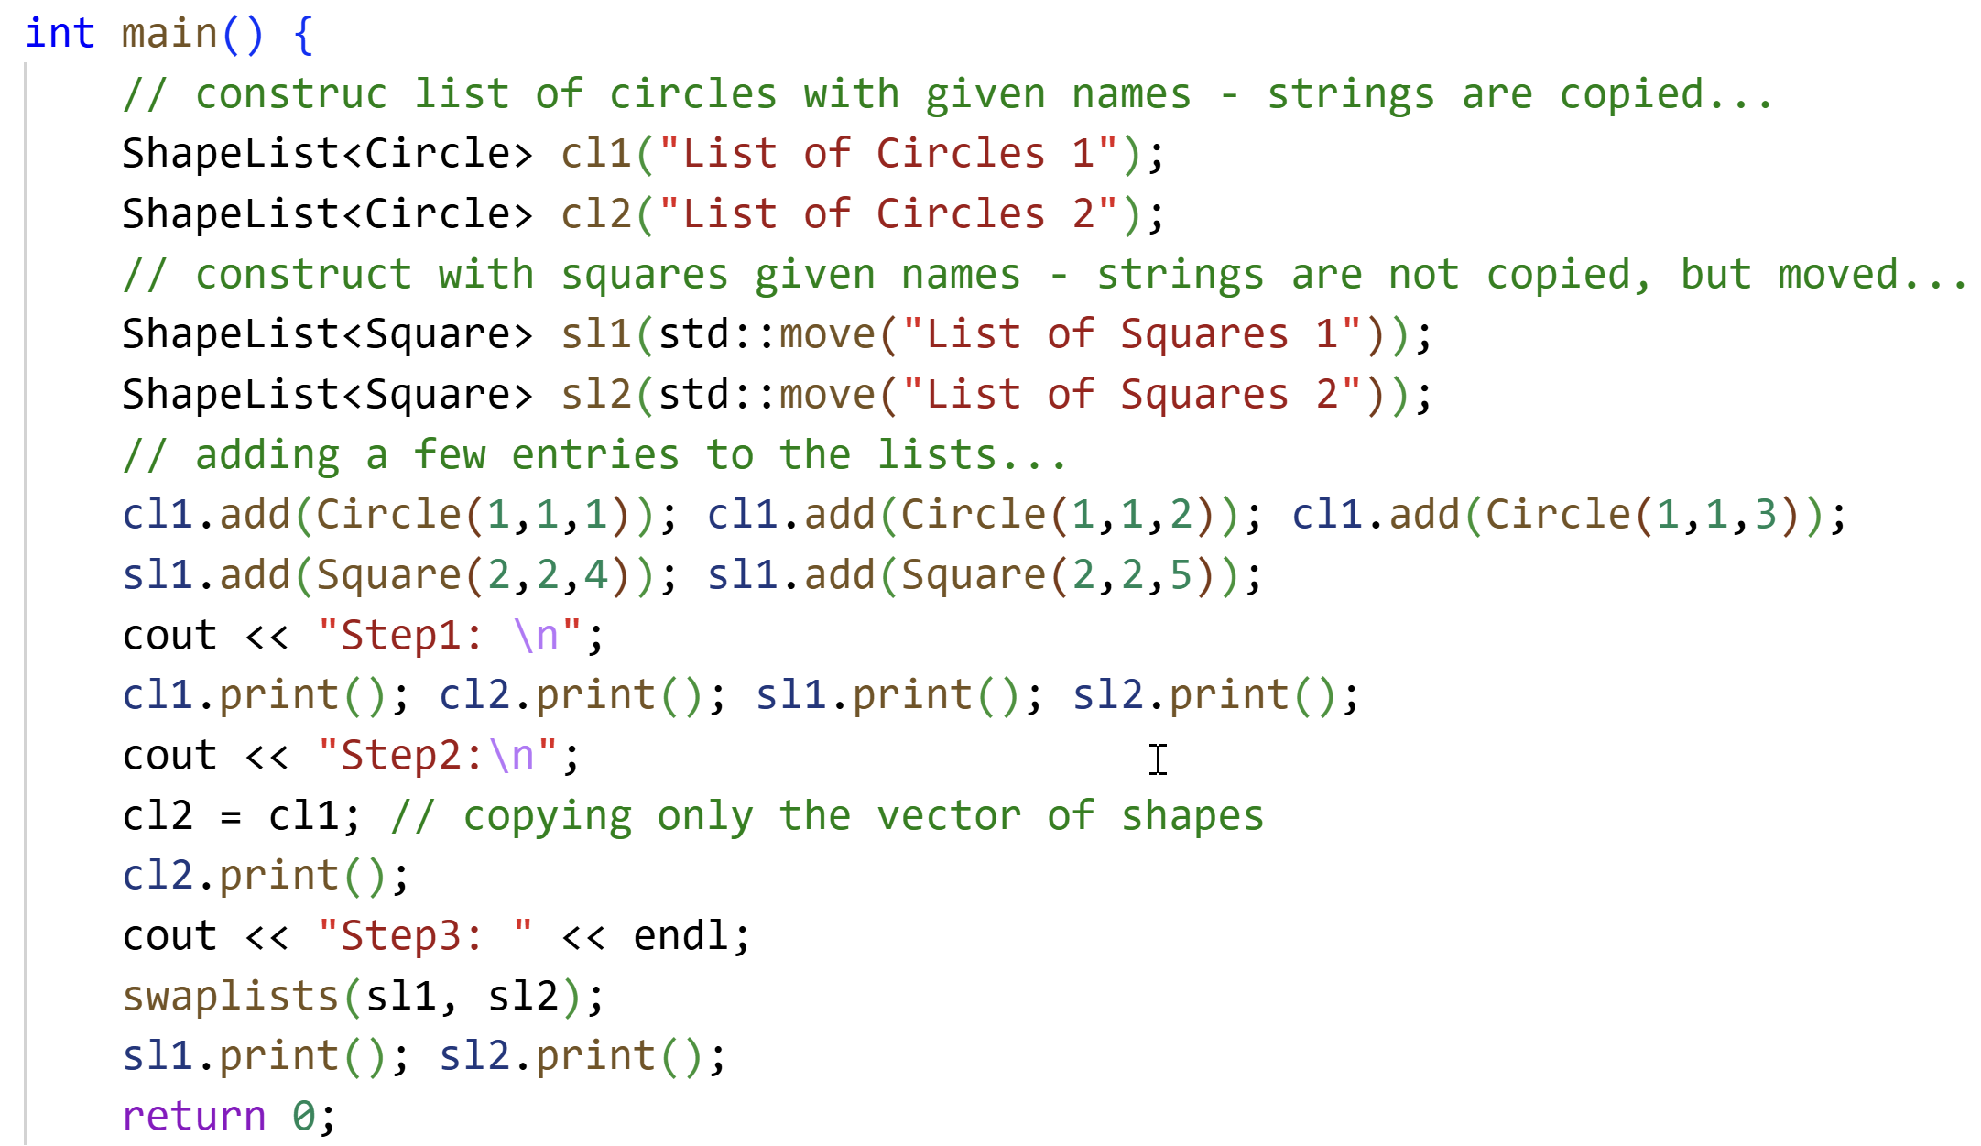
35 minutes…
Output
Step1:
List of Circles 1: {{1,1,1},{1,1,2},{1,1,3}}
List of Circles 2: {}
List of Squares 1: {{2,2,4},{2,2,5}}
List of Squares 2: {}
Step2:
List of Circles 2: {{1,1,1},{1,1,2},{1,1,3}}
Step3:
List of Squares 1: {}
List of Squares 2: {{2,2,4},{2,2,5}}
Template class ShapeList implements a strange version of value semantics. The objects of this class have two resources: a string name, and a vector data. name is managed by the constructors while data is managed by the assignment operators. Both version of copy and move semantics are available.
Study the given code its output and implement the class ShapeList with the correct semantics. You do not need to implement the Circle and Square classes and member function print. You need to implement swaplists which is a non-friend function.

